Slide 1
Persephone
Persephone
Goddess of Seasons and Queen of Underworld and *Lives in Underworld and on Earth* Married to Hades * Born on Earth
Persephone
January 16, near the River Styx
Stuck in the Underworld! Mom, will you please come down here and get me? Have you been looking for me? It’s so dark and cold down here. I miss the warm sunshine and the harvest up on earth. I’ve looked everywhere and haven’t seen any flowers or fruit. Well, there is a pomegranate tree here and Hades tried to trick me into eating from it, but I didn’t even want to try any of the food down here. I have no one to talk to. Will you please get me out of here!
Strengths
Sunshine! Fields! Flowers! Harvest!
These are a few of my favorite things. I have my strength when I
am on earth with my mother.
Hades
January 17, near Underworld
Persephone, the underworld has much to offer thee. You are the queen. You sit beside me on the throne ruling over this vast land of souls. I give you the most precious stones and gems. You have everything a girl could ever want or need. Why do you want to go back up the earth?
Friends
Demeter
Demeter
March 19, near a field on earth
It’s almost time for spring. Hades, the rich one, please keep our agreement and send Persephone back to the world. We are looking forward to the equinox when the flowers will bloom because my daughter will be coming home. It has been a long winter and I have missed her more this year than ever before.
Hades
Hades
March 27, 1917 near St. Petersburg
Persephone. It has been 6 days since you left. I will see you again in 6 months when you will return to the underworld to rule beside me.

Slide 2
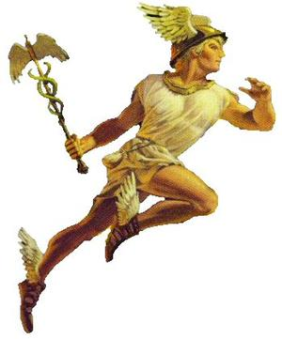
Persephone
Claude Monet
Persephone
Goddess of Seasons and Queen of Underworld and *Lives in Underworld and on Earth* Married to Hades * Born on Earth
Basic Info
About Persephone
I like gathering flowers and warm sunshine. Gold and precious stones are not my interest. Hades likes to give me these gifts, but I would rather be with my mother in the warmth of the fields.
I was born to Demeter, goddess of the harvest. My mother loved me so dearly that I never left her side. That is how it was. Until Hades grabbed me and brought me down to the underworld. Yuk! I hate it down here. It is so dark and cold. I have tirelessly searched for flowers down here and found none.
However, one day, I did find a pomegranate tree. Hades offered me some, but I refused. It just wasn’t the same as enjoying the harvest up on Earth. I still don’t trust Hades and thought it might be a trick.
It was good for me when Hermes came down and rescued me from the underworld. Then. that gardener got in the way. He said I DID eat from the pomegranate tree. I never did! I really don’t remember ever eating any of those seeds from this wretched place. Why are they always tricking me down here?
Zeus was able to make a deal with Hades. It is not the best deal, but, at least, I can go home for 6 months of the year! Yay! I just love the sunshine and the flowers and seeing my mom. It’s the best. It’s hard on mom when I have go back down to the Underworld. She grows old and the earth grows cold. It feels like a long time for us.
Friends
Demeter
Hades
Quotes
Favorite
Quotations
“Dear child, never again shall we be parted.” – Demeter
“ Parting is such sweet sorrow.” – Juliet Capulet from Romeo and Juliet
“ My brother saw the pigs disappear into the ground and heard a frightened girl cry.” - Triptolemus
Hermes

Slide 3
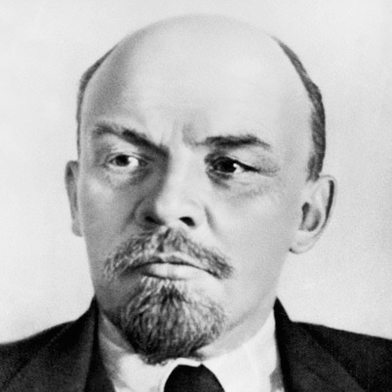
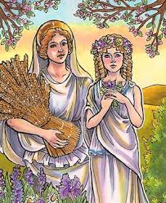
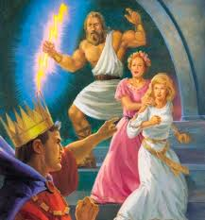
Vladimir Lenin
Photo Album
By Persephone *Updated 1 day ago
Here we are in our favorite field. My mom loves me - her only daughter – so much. When I am on earth with her, we are always side by and enjoyed gathering flowers and collecting grain for the harvest. I love having time on earth and the warm sunshine.
Me (on right) at the steps of the Underworld where Zeus is convincing Hades (with the crown on the left) that I should only spend six months down in his domain. This picture was taken by Hermes, who was helping me leave the underworld. You can see my helpful mom, who is by my side.

